Slide 1
Analysis of Phoenix, AZ Real Estate Trends
10/8/2019
Proletariats
Janine White
Jordan DellaMaddalena
WeiWei Tan

Slide 2
Methodology and Data Sources

Slide 3
Methodology
We decided to research Phoenix, AZ real estate prices.
We looked for datasets related to real estate prices. At Quandl we found Zillow aggregate data with 25 datasets related to Phoenix, AZ.
We also wanted to compare the real estate prices to inflation and found the Bureau of Labor Statistics consumer price index (CPI) data.
Critical Questions
Are real estate prices related to inflation in consumer prices?
Are real estate prices related to employment?
Were socioeconomic classes affected differently by the real estate boom and bust of the Great Recession?
Data was downloaded and cleaned,
25 Zillow datasets were downloaded from Quandl, aggregated and pivoted, then we selected the trends of interest.
CPI and Employment data was downloaded from Bureau of Labor Statistics.
Data was merged, analyzed and plotted.

Slide 4
Monthly Data Sources
Quandl Zillow Real Estate Research (Zillow Research)
C36159_SCSABT - Median Sales Count Bottom Tier
C36159_SCSAMT - Median Sales Count Middle Tier
C36159_SCSATT - Median Sales Count Middle Tier
C36159_SP – Median Sales Price
C36159_SPBT - Median Sales Price Bottom Tier
C36159_SPMT - Median Sales Price Middle Tier
C36159_SPTT - Median Sales Price Top Tier
C36159_FOR10K - Foreclosure rate per 10,000 homes
M14_PRRAH – Price to Rent Ratio
Bureau of Labor Statistics
Consumer Price Index
Primary Residence, Rent
Employment

Slide 5
Inflation

Slide 6
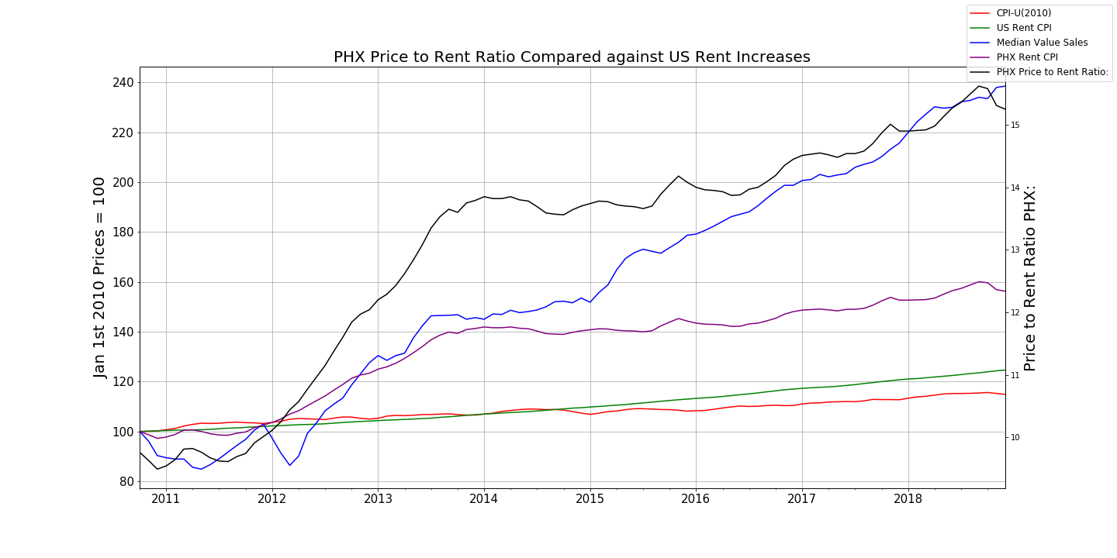
Phoenix, AZ Inflation
We can see on the graph that between 2010-10-31 and 2018-12-31 the average price of goods in America increased by 14%.
Using the 'OER' as an estimate for US rental values we can see that on average, rents have gone up 24.6% from 2010-10-31 to 2018-12-31.
The average rent in Phoenix has increased by 56%, over twice as fast as the national average.
In 2015 housing prices began to increasingly outpace increases in rents.

Slide 7
Employment

Slide 8
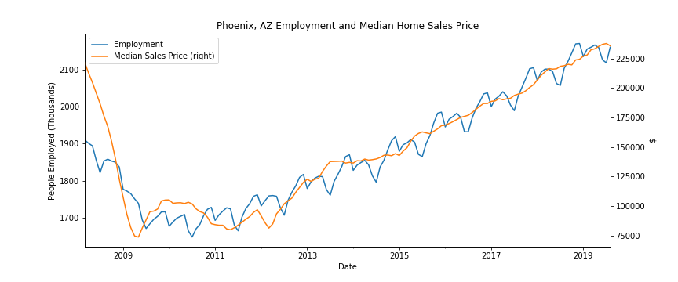
Phoenix, AZ Employment and Median Home Sale Prices
Before 2009, the median sales price was about 225,000 which is almost hit the highest point in the recently 10 years. The employment number in phoenix area before 2009, which was before the Great Recession, was about 1900 thousands still not bad. Between 2009 to 2013, the Great Recession was happening, more and more people lost the job and they can’t afford the loan of the houses. There were lots of foreclosure houses in the market, the price of houses was dropped down to the lowest point in the recently 10 years, and the home prices even fell faster than employment. After 2013, which after the Great Recession, there were more and more people find the job, employment number was raising up, home prices are also raising up.

Slide 9
Tier Analysis

Slide 10
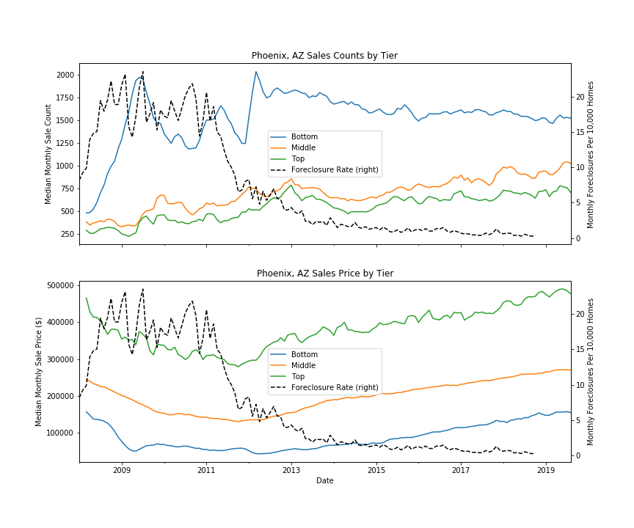
Phoenix, AZ Real Estate Monthly Sales Counts and Prices by Tier
Tier | Median Price Range 2008 - 2019
Bottom Third | $43,100 – $157,300
Middle Third | $130,300 - $271,400
Top Third | $279,100 – $489,900
The bottom tier was more immediately affected by the housing crisis of the Great Recession and accounted for most of the foreclosures.
All tiers appear to have similar price trends, with the middle tier least affected in the first year.

Slide 11
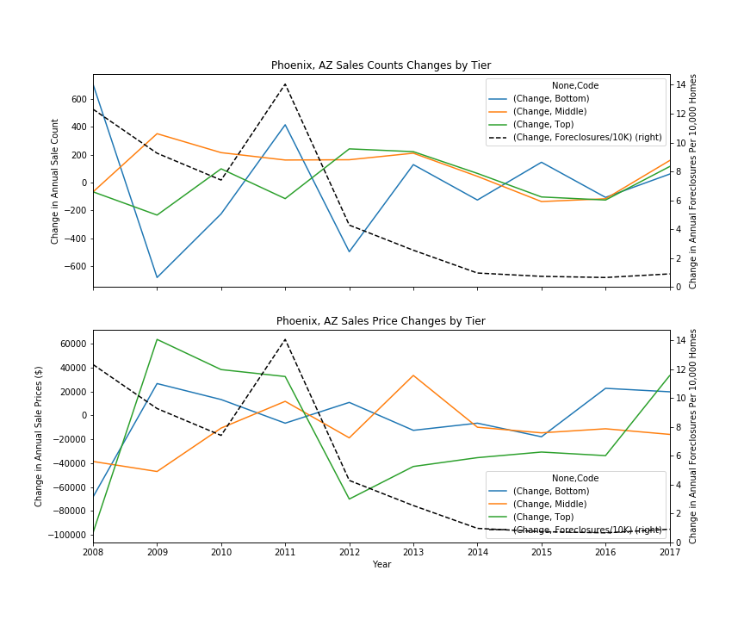
Phoenix, AZ Real Estate Annual Sales Counts and Price Changes
Coefficients of OLS regression by year were used to find the direction of annual change. The difference between the smallest and largest annual counts are prices are plotted, positive if counts or prices increased and negative if they decreased.
The bottom tier sales count tracked with the foreclosures rate until 2012.
Bottom and top tier sales prices were initially most affect by the Great Recession, although top tier prices struggled the most to recover between 2012 and 2016.

Slide 12
Conclusions

Slide 13
Conclusions
Phoenix rents and home prices are rising faster than Phoenix and US CPI. Phoenix CPI is rising faster than US CPI.
Median home sales prices are closely related to employment. During the Great Recession, home prices fell faster than employment.
The bottom tier was most affected by the housing bubble Great Recession in counts and sales prices, but the top tier also struggled to recover once affected.

